Slide 1

SOP title (e.g. Box Former Changeover)
REFERENCE
MD-ENG-BU-XXX
AREA / DEPARTMENT
Butter: XXXX
DOCUMENT OWNER
Production Manager
AUTHOR
Name
VERSION
1
EFFECTIVE FROM
[Publish date]
MACHINE NUMBER
XXXX
APPROVED BY
Name
SUMMARY OF PROCESS STEPS
1.1 | Summarise the step in a few words
1.2 | Summarise the step in a few words
1.3 | Summarise the step in a few words
1.4 | Summarise the step in a few words
1.5 | Summarise the step in a few words
1.6 | Summarise the step in a few words
1.7 | Summarise the step in a few words
1.8 | Summarise the step in a few words
1.9 | Summarise the step in a few words
1.10 | Summarise the step in a few words
1.11 | Summarise the step in a few words
1.12 | Summarise the step in a few words
PROCESS OVERVIEW
Task duration: XX mins
Who: Technical Operator, Trainee Technical Operator
How to: One-line description of the task

Slide 2


















Before you start
PPE REQUIRED
HAZARDS
SPECIFIC TOOLS
Standard Setting Sheet
Add tool
SAFETY DOCUMENTS
Delete any signs not required
Risk assessment | HS-RA-BU-10, HS-RA-BU-19
Permit to work | N
COSHH | N
Other | N
SAFETY IMPLICATIONS
QUALITY IMPLICATIONS
COST IMPLICATIONS
PPE
Vehicle movement
Hot surfaces
Moving parts
Cleanliness
Correct packaging
Box formation
Gluing
Downtime
Waste
Machine efficiency

Slide 3
STEP 1.1

Slide 4
STEP 1.2

Slide 5
STEP 1.3

Slide 6
STEP 1.4

Slide 7
STEP 1.5

Slide 8
STEP 1.6

Slide 9
STEP 1.7
STEP 1.8

Slide 10
STEP 1.9
STEP 1.10
STEP 1.11
STEP 1.12

Slide 11
Validation, approval & version control
SOP VALIDATION
SOP APPROVAL
Name | Signature | Date
Name | Signature | Date
VERSION CONTROL
Date amended | Version | Reason for change | Name
XX/XX/XXXX | 1 | New SOP

Slide 12


How to use this template
REFERENCE ONLY – DELETE THIS SECTION BEFORE PUBLISHING
1
Fill in the header and footer once
View › Slide Master, then click the top (largest) master slide. Edit the SOP title, reference, version, machine and approver there and every slide updates.
WRITING STYLE
Font: Arial throughout, black text
Start each ‘What you do’ with a verb
One action per bullet in ‘How you do it’
Show changes in bold italic
Left-align all text
2
Add a step
Home › New Slide › choose “SOP - Step” (one step per slide, best for training on screen) “SOP - Two steps” or “SOP - Four steps” (for short, simple steps).
3
Add photos
Click the camera box on a step slide and pick a picture. It is cropped to fit automatically.
ARROWS & MARKERS (COPY AND PASTE)
4
Mark critical steps
Copy the Safety, Quality or Cost triangle from the sign library onto a step to flag it.
5
Keep the summary in sync
Update ‘Summary of process steps’ on slide 1 whenever you add, remove or reorder steps.
Arrows and circles highlight areas on photos. Ticks and crosses show right vs wrong.

Slide 13
Getting an SOP approved in Q-Pulse
REFERENCE ONLY – DELETE THIS SECTION BEFORE PUBLISHING
1
2
3
4
Define approval level
Agree the approval level. If feasible, let approvers preview before formal submission.
Create document record
An Administrator creates the Document Record in Q-Pulse and passes control to the Owner.
Submit draft
The Owner submits the draft and defines the Approvers and Copyholders.
Set the approval route
Choose Parallel or Sequential, and whether Quality or Site Leadership must approve.
5
6
7
Approve or reject
If an Approver rejects, the Owner edits and resubmits the document.
Activate
Once everyone has approved, the Owner activates the document, releasing it to the business.
Read & understood
Copyholders read the SOP and sign digitally to confirm they understand it.

Slide 14
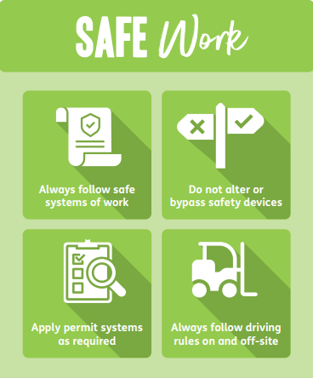
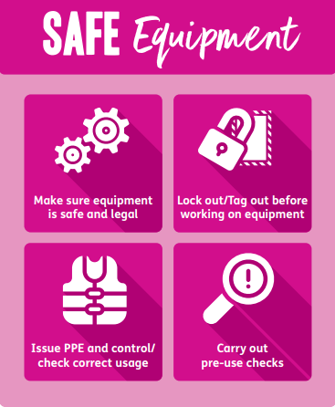






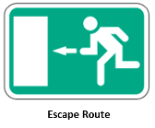


Sign library
REFERENCE ONLY – COPY THE SIGNS YOU NEED, THEN DELETE THIS SECTION
MANDATORY / PPE
SAFE RULES
HAZARD
STEP FLAGS
Safety
Quality
Cost
EMERGENCY & PROHIBITION
More signs: HSE L64 hse.gov.uk/pubns/priced/l64.pdf

